Slide 1


托福听力9
金牌听力名师
大菁儿老师
2021.6.21

Slide 2
第八节课回顾： 十大考点——过程+结论； botany+环境科学词汇串讲及菁讲精练

Slide 3
二级学科词汇精讲：
business
TPO6 lecture1
TPO21 lecture2
history
TPO10 lecture2
TPO18 lecture3

Slide 4
business 场景词汇
brand loyalty [brænd] ['lɔɪəlti] 品牌忠诚度
toll [tol] n.通行费
supply-demand [sə'plaɪ] [dɪ'mænd] 供需
consume [kən'sum] vt.消耗，消费
consumer [kən'sumɚ] n.消费者
consumption [kən'sʌmpʃən] n.消费；消耗
cost-effective adj.划算的；成本效益高的
marketing ['mɑrkɪtɪŋ] n.销售,经销
product attribute [ə'trɪbjut] 商品特性
strategy ['strætədʒi] n.战略, 策略
campaign [kæm'pen] n.活动
commercial [kə'mɝʃəl] adj.商业的
manufacture ['mænjə'fæktʃɚ] v.制造
media ['miːdɪə] n.媒体

Slide 5
business 场景词汇
advertisement [,ædvɚ'taɪzmənt] n.广告
advertising ['ædvɚ'taɪzɪŋ] adj.广告的
appeal [əˈpi:l] v.上诉；呼吁；n.呼吁；吸引力，感染力；
billboard ['bɪlbɔrd] n.广告牌
collaborate [kəˈlæbəret] v.合作，协作
boom and bust [bum ənd bʌst] 经济繁荣与萧条的交替循环
accounting [ə'kaʊntɪŋ] n.会计；会计学；会计制度
bill [bɪl] n.账单
financial [faɪ'nænʃl] adj.金融的；财政的，财务的
budget ['bʌdʒɪt] n.预算
constrain [kənˈstren] vt.限制；约束
intensify [ɪnˈtɛnsəˌfaɪ] vt.& vi.（使）增强，（使）加剧
merchant ['mɝtʃənt] n.商人
mortgage [ˈmɔrɡɪdʒ] vt.抵押
organize [ˈɔ:gənaɪz] v.组织；安排
promissory note ['prɑmə,sori] - 期票，本票
rates [rets] n.价格，等级

Slide 6
business 场景词汇
risky [ˈrɪski] adj.冒险的，危险的
seize [si:z] v.抓住
auction ['ɔ:kʃən] n.拍卖
bid [bɪd] vt.投标；出价
privatize ['praivə,taiz] vt.使私有化
retail ['ritel] vt.零售
wholesale ['holsel] n./v.批发
lease [lis] n.租约；租期；租赁物；租赁权；vi.出租
beneficiary [,beni'fiʃəri] n.受益人
per capita [pɚ] ['kæpɪtə] 人均
profit ['prɑfɪt] n.利润
interest ['ɪntrəst] n.利息
commodity [kə'mɑdəti] n.商品，货物
foundation [faʊn'deʃən] n.基金会
integration ['ɪntə'greʃən] n.集中，集成；整合，一体化
affluence ['æflʊəns] n.富裕
face value [fes] ['vælju] n.面值

Slide 7

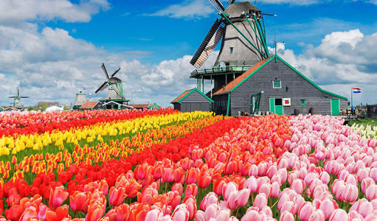
business 精讲精练：
TPO6 -lecture1 boom and bust(tulip mania)
dot-com crash
hysterical
irrational
hail from
mountainous region
Turkish nomad
merchant and diplomat
thrilling new commodity 兴奋的、紧张的
novelty (unheard of)
enormous
exotic
disposable income
speculation
panic 恐慌

Slide 8
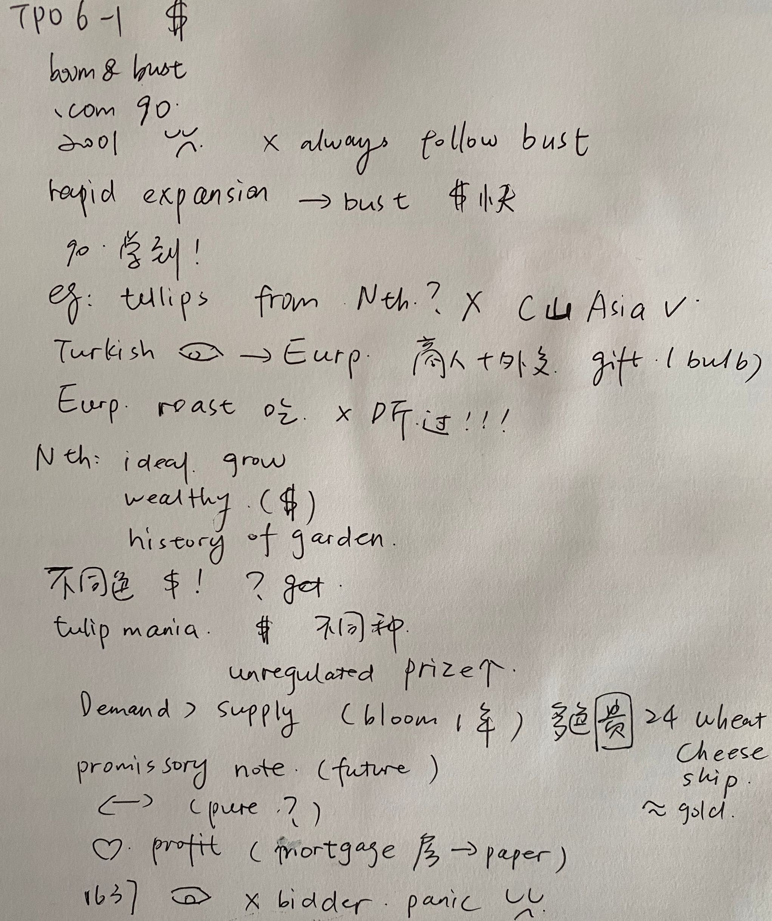
TPO6
lecture1
笔记

Slide 9
TPO6-lecture1
1. what is the main purpose of the talk
A. to show what happens after an economy has experienced a boom-and-bust cycle
B. to illustrate the conditions needed to produce a boom-and-bust cycle
C. to demonstrate how boom-and-bust cycles have changed over time
D. to explain why the boom-and-bust cycle is not a frequent historical occurrence

Slide 10
TPO6-lecture1
2. what is the professor’s opinion about the dot-com crash
A. she thinks that people should have realized it would happen
B. she does not believe that anything like it will happen again
C. she is surprised that it did not have more serious consequences
D. she is confident that people learned a valuable lesson from it

Slide 11
TPO6-lecture1
3. according to the professor, where did tulips originate
A. the mountains of central Asia
B. the region around Istanbul in Turkey
C. the sandy soils of the Netherlands
D. the forests of northern Europe

Slide 12
TPO6-lecture1
4. why does the professor mention a merchant who ate tulip bulbs
A. to explain how the Turks introduce the flower to European visitors
B. to explain what happened to tulip bulbs that did not produce desirable colors
C. to give an example of one way that the rich in the Netherlands showed off their wealth
D. to illustrate her point that Europeans were unfamiliar with the flower

Slide 13
TPO6-lecture1
5. what were some of the factors that contributed to the tulip craze in the Netherlands in the seventeenth century(3)
A. wealthy gardeners liked to complete for rare plants
B. the number of people with disposable income was growing
C. tulip bulbs were initially cheap and easy to obtain
D. tulips in the wild bloomed in unusual color combination
E. the tulip market was not regulated by the government

Slide 14
TPO6-lecture1
6. the professor mentions the practice of trading promissory note in the Netherlands in the 1630s,what does this practice explain(2)
A. why tulips replaced gold as a form of currency
B. why buyers were no longer interested in owning actual tulips
C. why borrowing in the Netherlands increased on a significant scale
D. why the middle class in the Netherlands expanded in size

Slide 15

TPO21-lecture2 软件开发
program code
computer circuit
moth
bias
mentality 心态
constructive
creative
friction/conflict
project unity
project split
defect
proactive and effective 前瞻性（先发制人）和有效性

Slide 16
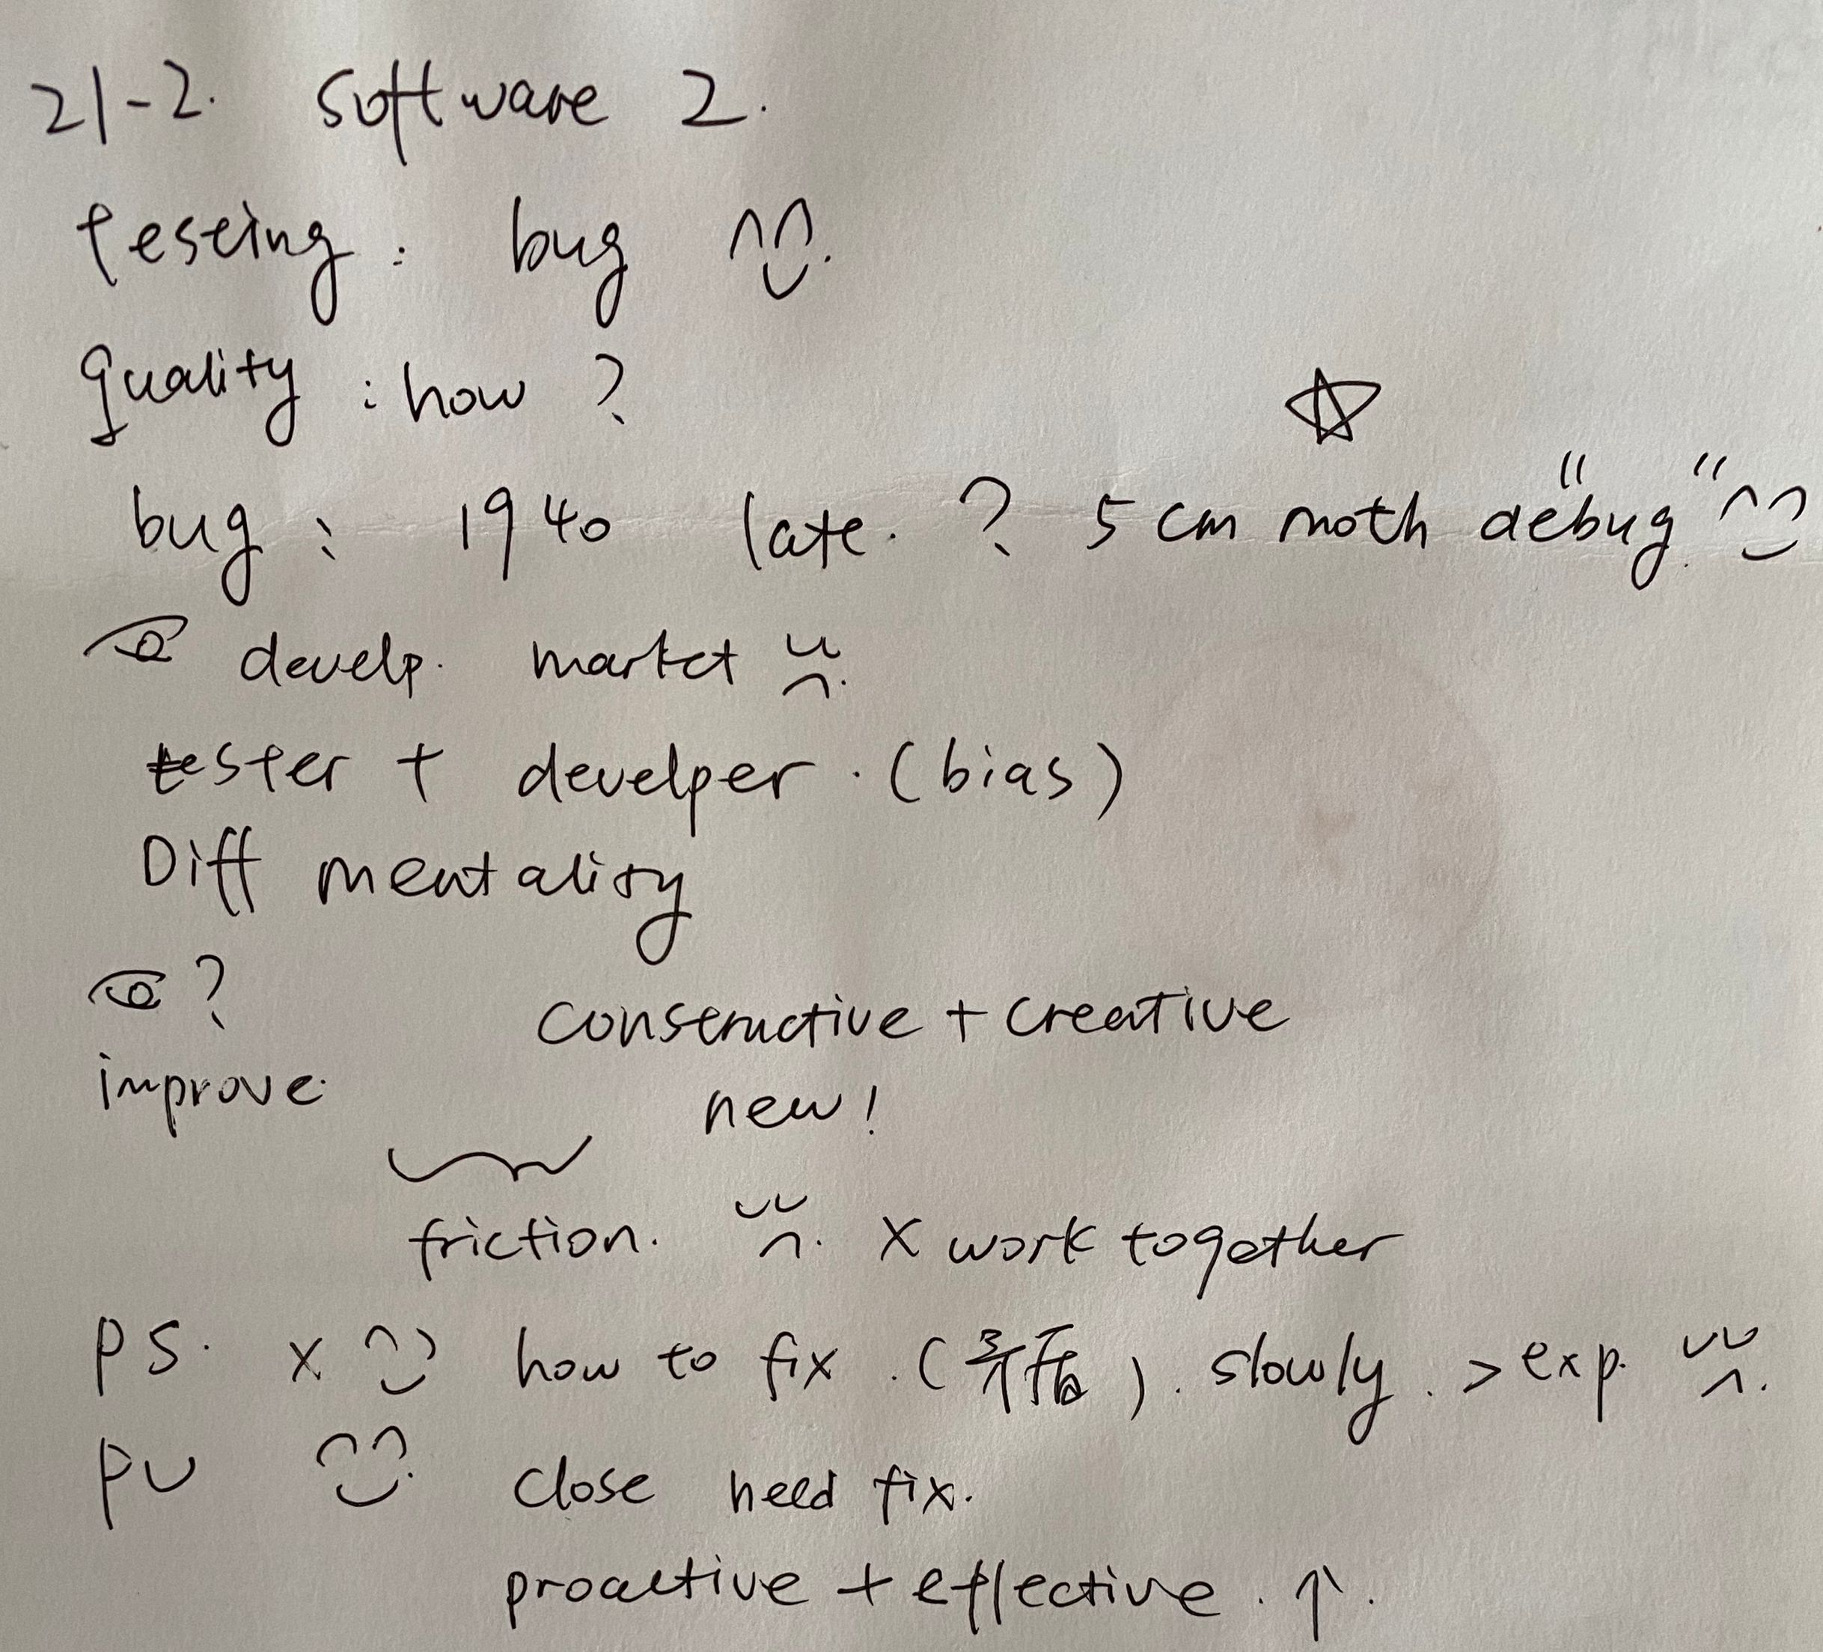
TPO21-lecture2
笔记

Slide 17
TPO21-lecture 2
1. What is the main purpose of the lecture?
A. To describe some recent improvements in computer technology
B. To explain why so many software products have flaws when they are put on the market
C. To show that creating good software depends on people with distinct roles working well together
D. To discuss how the software development process has evolved since the time of early computers

Slide 18
TPO21-lecture 2
2. According to the professor, where does the term "bug" used for computer problems come from?
A. It originated because of similar between computer virus and real virus.
B. It is based on an incident in which an insect interfered with the function of any early computer.
C. It was first used by early computer scientists who noticed small problems in programming code.
D. It was first used by developers who did not like testers identifying problems in their work.

Slide 19
TPO21-lecture 2
3. What points does the professor make about software developers? Click on 2 answers.
A. The work they do is mainly creative.
B.They enjoy the challenge of identifying problems to fix.
C. Their work is easier than the work of software testers.
D. They are not always able to detect software problems.

Slide 20
TPO21-lecture 2
4. What factor made work on Project Unity efficient?
A. No unplanned changes were made during defect meetings.
B. The teams focused on fixing only major problems.
C. The software developers were not defensive about problems detected by the testers.
D. Some of the software testers had previous experience as software developers.

Slide 21
TPO21-lecture 2
5. How did the software product developed during Project Split differ from the product developed during Project Unity?
A. The Project Split product was released to the market in a shorter amount of time.
B. The Project Split product could be used in more types of computer systems.
C. The Project Split product cost less money to develop.
D. The Project Split product was of inferior quality.

Slide 22
TPO21-lecture 2
6. when the professor discusses some work meetings attended by two teams, why does he say this:
A. To emphasize the fact that to the teams were in conflict with on another
B. To make the point that testers are just as important as developers
C. To indicate that the teams had different ideas about how to market the new software
D. To emphasize the importance of meetings in the development process

Slide 23
history场景词汇
era ['ɪrə] n.时代；年代；纪元
medieval [,midɪ'ivəl] adj.中世纪的
The Enlightment - [ɪn'laɪtnmənt] 启蒙运动
industrial revolution [ɪn'dʌstrɪəl][revə'luːʃ(ə)n] 工业革命
the Great Depression - [dɪ'prɛʃən] 大萧条（美国经济大萧条时期）
colony ['kɑləni] n.殖民地
colonize [ˈkɒlənaɪz] v.开拓为殖民地
conquer ['kɑŋkɚ] v.战胜，征服；攻克，攻取
imperial [ɪm'pɪrɪəl] adj.帝国的；皇帝的；至高无上的；威严的
Roman Empire ['romən] ['ɛmpaɪr] 罗马帝国
emperor ['ɛmpərɚ] n.皇帝；君主
clergy ['klɝdʒi] n.神职人员；牧师；僧侣
monastery ['mɑnəstɛri] n.修道院；僧侣
worship ['wɝʃɪp] n./v.崇拜；礼拜；尊敬
worshipper ['wɝʃɪpɚ] n.崇拜者；敬神者，拜神者

Slide 24
history场景词汇
prayer [prɛr] n.祈祷，祷告
aristocracy [,ærɪ'stɑkrəsi] n.贵族；贵族统治；上层社会
aristocrat [ə'rɪstəkræt] n.贵族
monarch ['mɑnɚk] n.帝王，君主，最高统治者
monarchy ['mɑnɚki] n.君主制；君主国
noble ['nobl] adj.高尚的；贵族的
peasant ['pɛznt] n.农民；乡下人
knight [naɪt] n.骑士
route [rut] n.路线，航线
benchmark ['bɛntʃmɑrk] n.基准

Slide 25
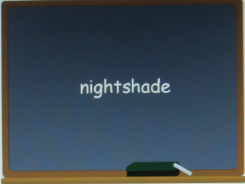
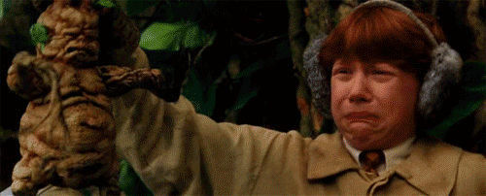
TPO10 - lecture2 美洲农作物的引入
squash 南瓜
cultivate
poisonous
inedible
conventional thinking
political power
Mediterranean
mandrake, belladonna颠茄, tobacco
茄属植物
双子叶植物纲、管状花目、茄科植物，约2000余种，分布于全世界热带及亚热带地区，少数达到温带地区，主要产南美洲的热带。中国有39种，14变种
🍅+枸杞

Slide 26
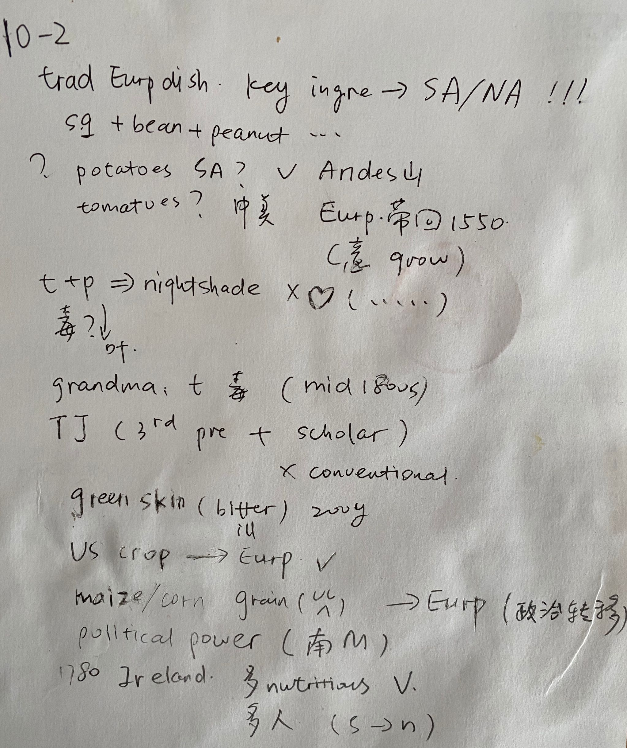
TPO10-lecture2
笔记

Slide 27
TPO10-lecture 2
1. What is the main purpose of the lecture ?
○ To describe the trade in food crops between Europe and Americas
○ To describe the introduction of American food crops to Europeans
○ To describe the influence of American food crops on traditional Europeans
○ To describe the difficulties of growing American food crops in European climates

Slide 28
TPO10-lecture 2
2 What does the professor imply about certain plants in the nightshade family?
○ They grow best in Mediterranean climates
○ Their leaves are high in nutritional value
○ They were mistakenly believed to be related to potatoes
○ They are dangerous when eaten by human beings

Slide 29
TPO10-lecture 2
3. What does the professor imply about Thomas Jefferson's attitude toward tomatoes?
○ It was typical of his unconventional way of thinking
○ It helped to advance his political career
○ It changed the eating habits of North Americans
○ It helped to make tomatoes popular in Europe

Slide 30
TPO10-lecture 2
4. According to the professor,what was the long-effect of the intorduction of American corn and potatoes to Europe?
○ It had a negative effect on the nutritional intake of people living near the Mediterranean Sea
○ It contributed to a shift in the balance of power from southern Europe to northern Europe
○ It encouraged the development of new types of cuisine in southern Europe
○ It led to the failure of many native European grain crops

Slide 31
TPO10-lecture 2
5. According to the professor ,what is one of the reasons why potatoes became popular in Ireland?
○ Potatoes were more nourishing than native Irish food crops
○ Potatoes grew better at higher altitudes than native Irish crops
○ Political leaders in Ireland encouraged the cultivation of potatoes
○ People in Ireland were not aware that potatoes are members of the nightshade family

Slide 32
TPO10-lecture 2
6. Listen again to part of the lecture Then answer the question
What can be inferred about the professor when she says this
○ She expects the student to provide an answer to her question
○ She is surprised by the student's question
○ She thinks that she knows what the student was going to ask
○ She expects other students in the class to express their opinions

Slide 33
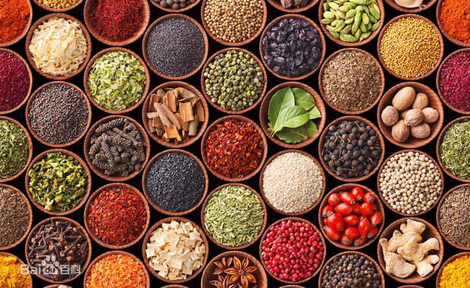
TPO18 -lecture3 香料的地位
spice
ginger
pepper 胡椒
heads of state and ambassadors
medieval
flower bud
preservatives 防腐剂
mythical
religious ritual
preserve
spoiled food
aristocracy 贵族
astronomical 天文的/多的
shroud 裹尸布/ 遮盖
allure 吸引（adj.alluring）
repercussion 反响

Slide 34
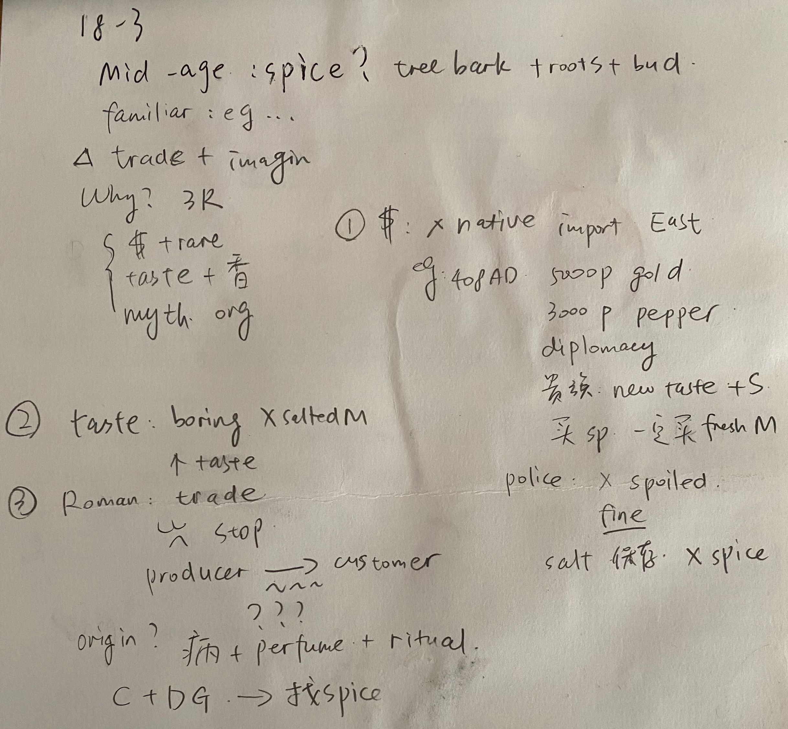
TPO18-lecture3
笔记

Slide 35
TPO18-lecture 3
1. What is the main purpose of the lecture?
A. To explore the use of spices in conking in the Middle Ages
B. To explain the significance of spices for medieval society
C. To describe how the spice trade evolved in medieval Europe
D. To examine changes in the role that spices played in the Middle Ages

Slide 36
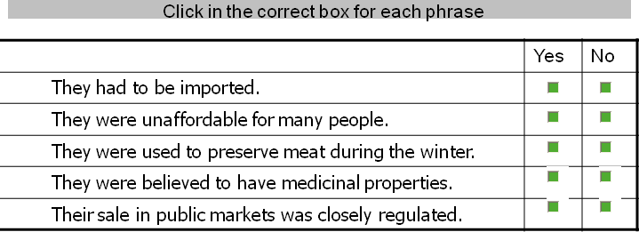
TPO18-lecture 3
2

Slide 37
TPO18-lecture 3
3. What two factors explain why medieval Europeans did not use spices to cover the taste of spoiled meat?
A. Fresh meat was less expensive than spices were.
B. Spices were mainly used in incense and perfume.
C. The sale of spoiled food was prohibited.
D. Salt was cheaper than most spices were.

Slide 38
TPO18-lecture 3
4. Why does the professor mention the collapse of the Roman Empire?
A. To indicate that the spice trade became mere direct
B.To explain why the price of pepper suddenly increased
C. To indicate that spices were not available in Europe for centuries
D. To explain why the origins of spices became more mysterious

Slide 39
TPO18-lecture 3
5. What does the professor say about European explorers during the age of discovery?
A. Their discoveries caused the price of certain spices to increase
B. They were responding to the demand for spices.
C. They did not expect to find spices during their explorations.
D. Their main goal was to discover unknown lands.

Slide 40
TPO18-lecture 3
6. Why does the professor say this:
A. To indicate that pepper was commonly used as payment
B. To indicate where pepper could be found at the time
C. To emphasize the high value of pepper at the time
D. To suggest that pepper was nearly as plentiful as gold

Slide 41
课后作业：
1. 回顾本次课内容，business+history单词记忆内容
2. 完成TPO38-2；42-4；47-3;
53-3;51-2;45-1的所有lecture题目
3. 预习第10次课中人类学+建筑学词汇
题目群里打卡

Slide 42
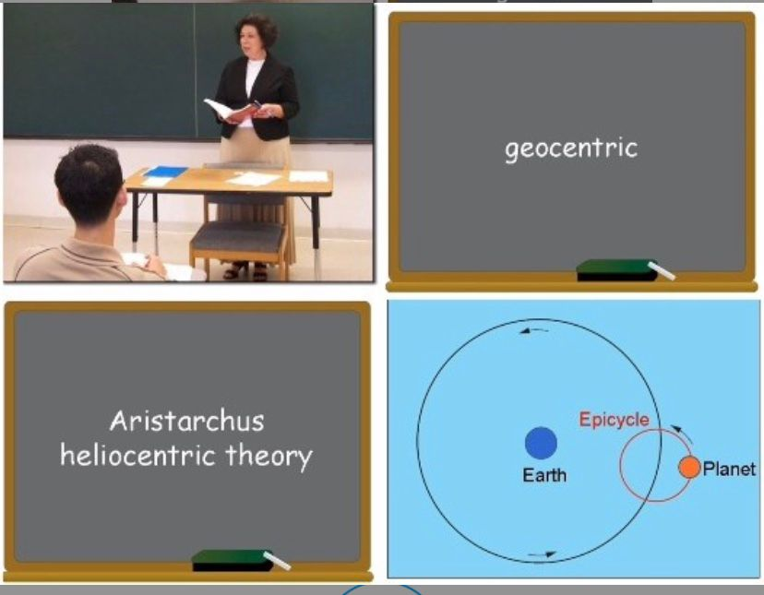
综合练习：
TPO21-L1

Slide 43
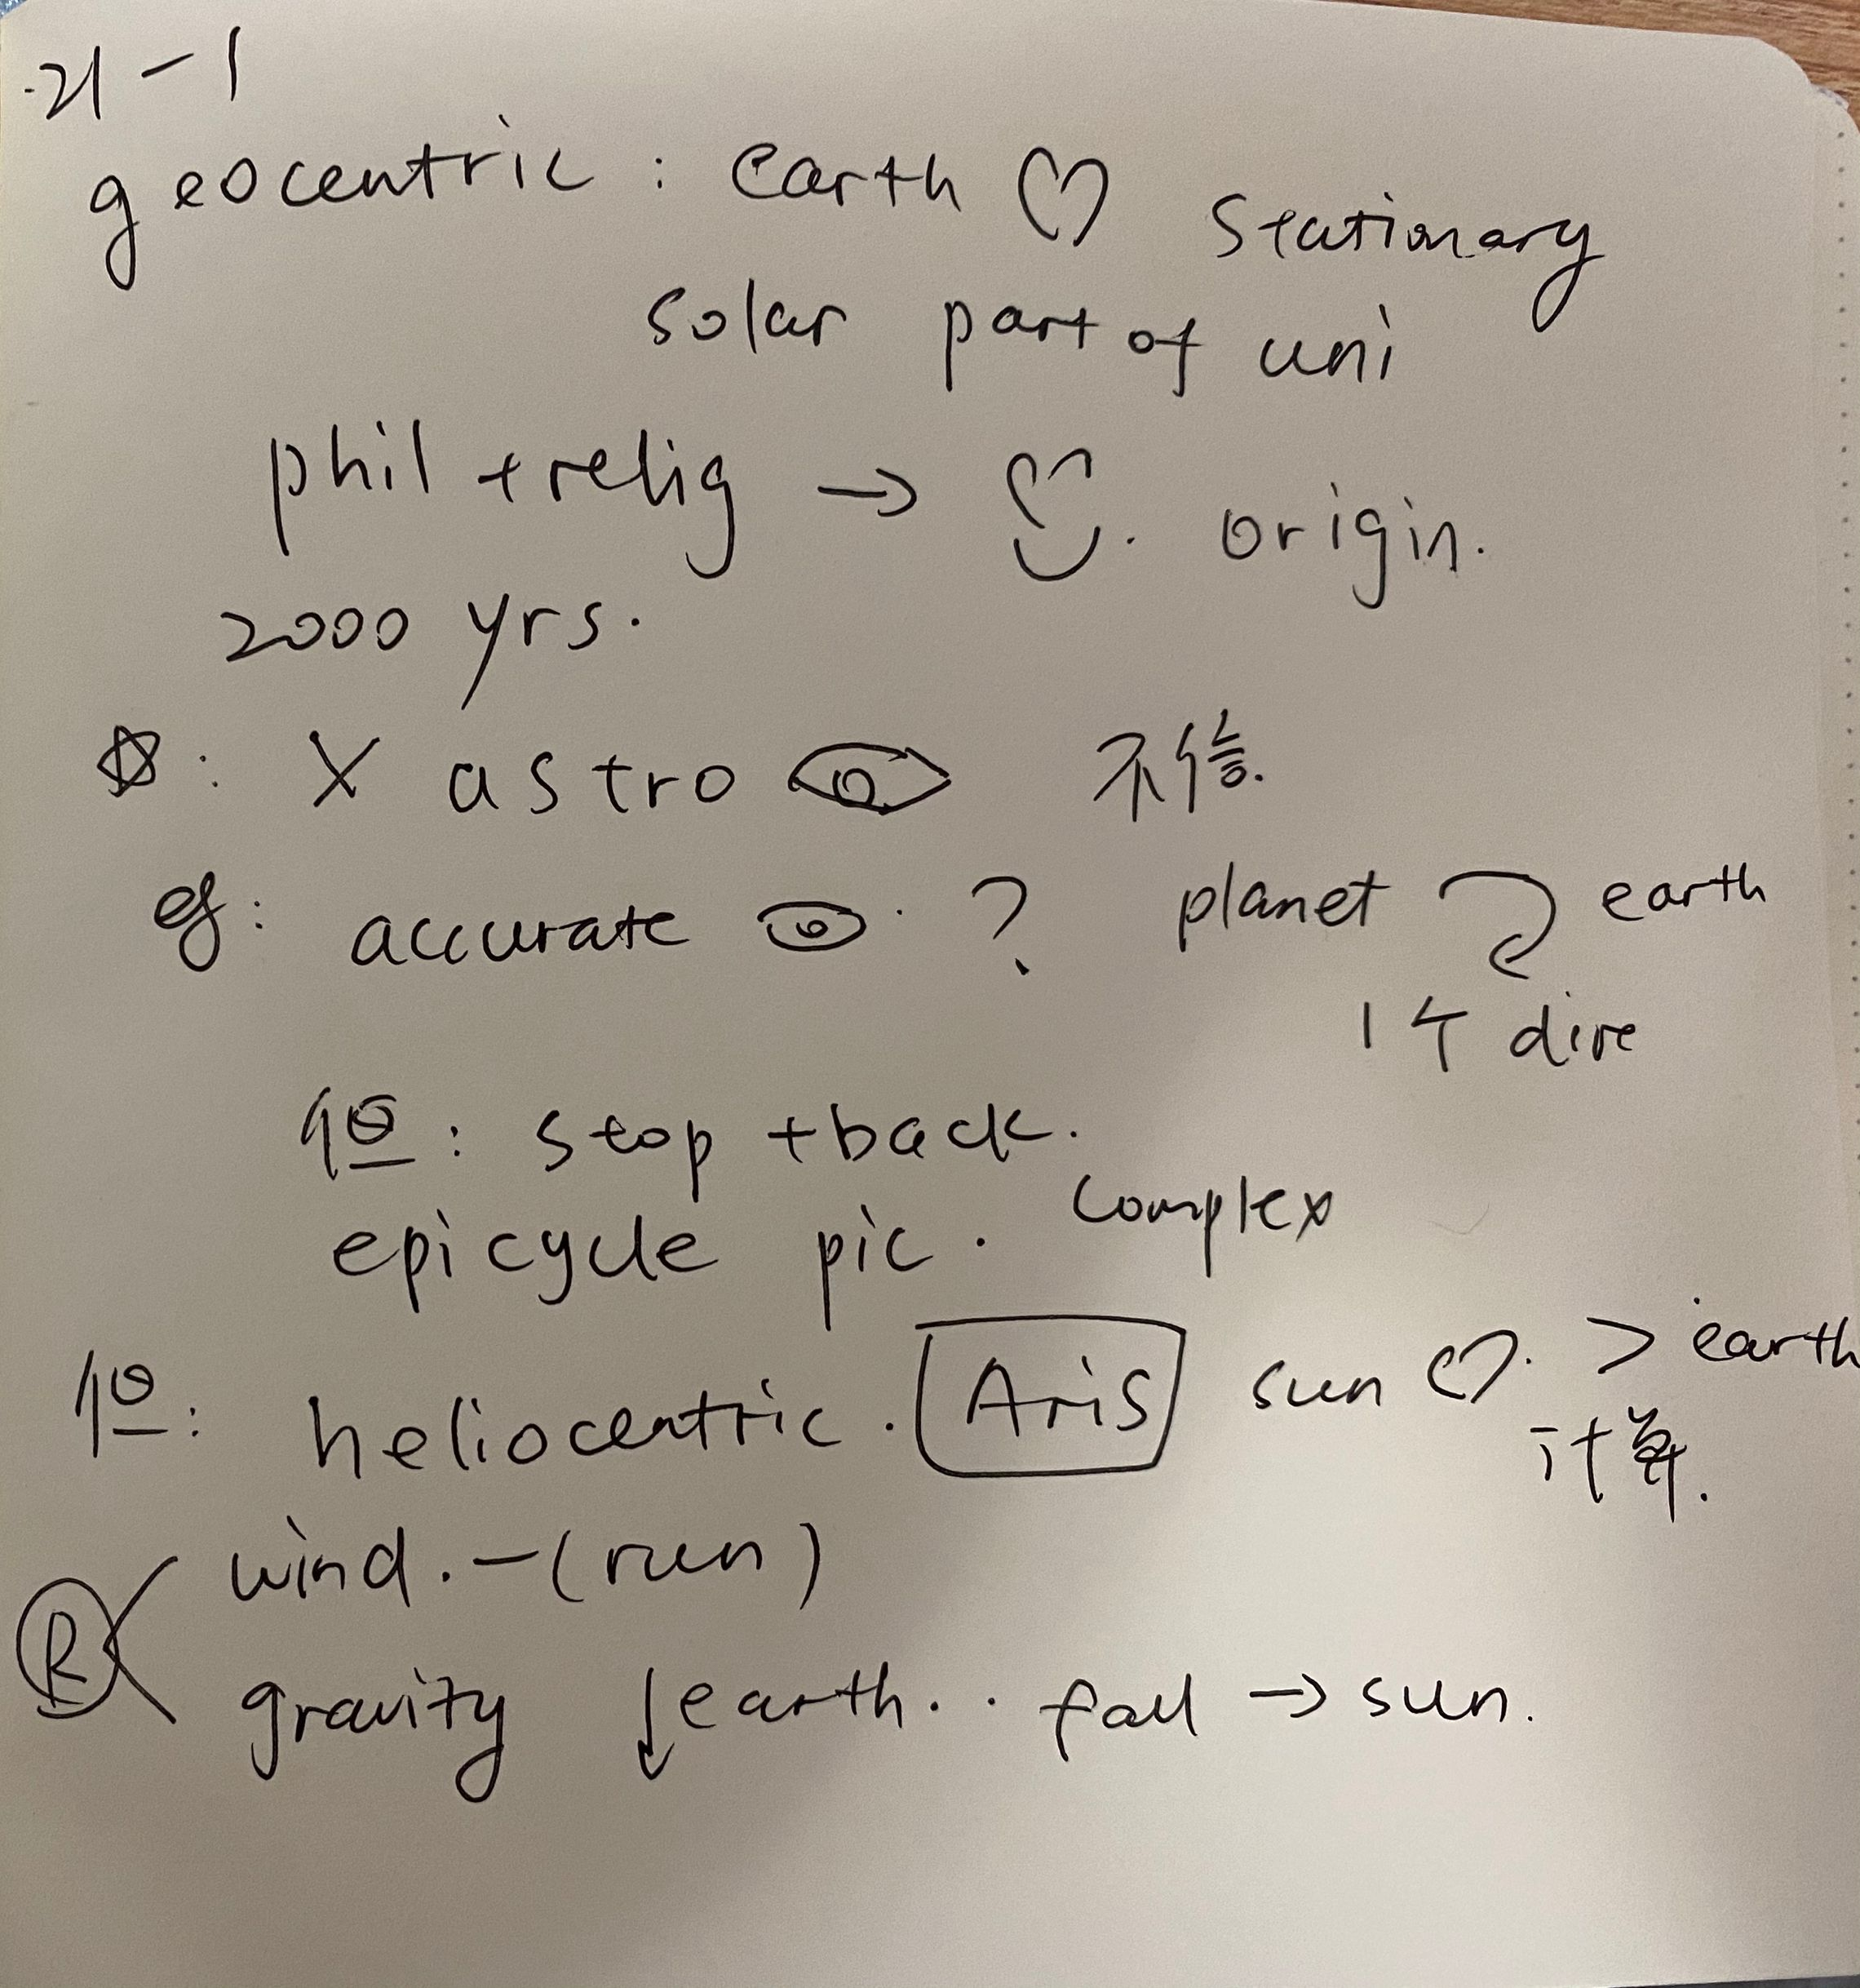
综合练习：
TPO21-L1

Slide 44
End

